Slide 1
Search

Slide 2
http://ai.berkeley.edu/course_schedule.html

Slide 3
Abstraction
What is abstraction?
What is the benefit of abstraction?
What is potential danger of abstraction in education?

Slide 4

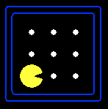





Search Problems
A search problem consists of:
A state space
A successor function
(with actions, costs)
A start state and a goal test
A solution is a sequence of actions (a plan) which transforms the start state to a goal state
“N”, 1.0
“E”, 1.0
Notes:
Often comes back on exams
Goal test – sometimes more than one state that satisfies having achieved the goal, for example, “eat all the dots”
Abstraction

Slide 5

Search Problems Are Models

Slide 6
Example: Traveling in Romania
State space:
Cities
Successor function:
Roads: Go to adjacent city with cost = distance
Start state:
Arad
Goal test:
Is state == Bucharest?
Solution?

Slide 7
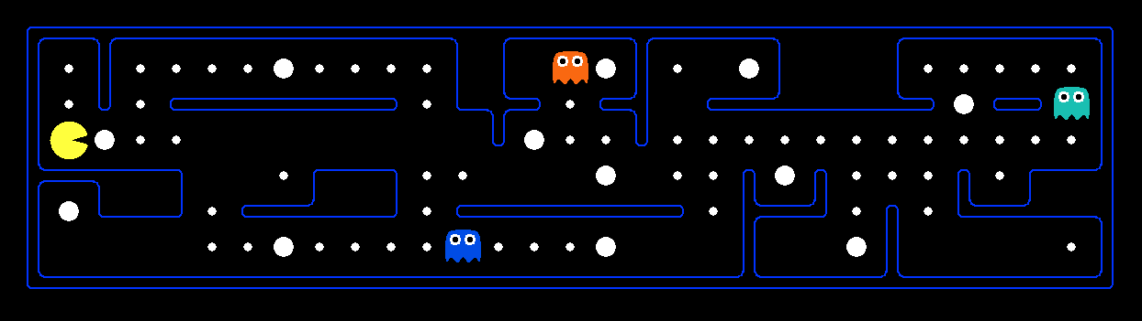
What’s in a State Space?
The world state includes every last detail of the environment
A search state keeps only the details needed for planning (abstraction)
Problem: Pathing
States: (x,y) location
Actions: NSEW
Successor: update location only
Goal test: is (x,y)=END
Problem: Eat-All-Dots
States: {(x,y), dot booleans}
Actions: NSEW
Successor: update location and possibly a dot boolean
Goal test: dots all false
Notes:
Wrong example for “eat-all-dots”: (x, y, dot count)

Slide 8
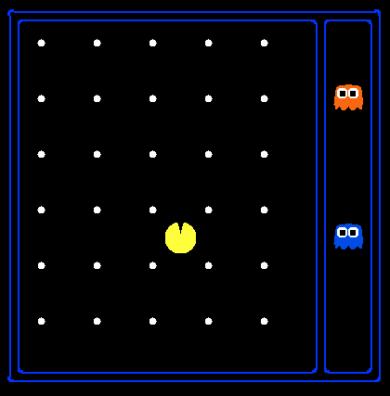
State Space Sizes?
World state:
Agent positions: 120
Food count: 30
Ghost positions: 12
Agent facing: NSEW
How many
World states?
120x(2³⁰)x(12²)x4
States for pathing?
120
States for eat-all-dots?
120x(2³⁰)
Notes:
90 * (2^30-1) + 30 * 2^29 = 145 billion
2^29 = 536 870 912

Slide 9
Quiz: Safe Passage
Problem: eat all dots while keeping the ghosts perma-scared
What does the state space have to specify?
(agent position, dot booleans, power pellet booleans, remaining scared time)

Slide 10
class SearchProblem: """ This class outlines the structure of a search problem, but doesn't implement any of the methods (in object-oriented terminology: an abstract class). You do not need to change anything in this class, ever. """ def getStartState(self): """ Returns the start state for the search problem. """ util.raiseNotDefined() def isGoalState(self, state): """ state: Search state - Returns True if and only if the state is a valid goal state. """ util.raiseNotDefined() def getSuccessors(self, state): """ state: Search state - For a given state, this should return a list of triples, (successor, action, stepCost), where 'successor' is a successor to the current state, 'action' is the action required to get there, and 'stepCost' is the incremental cost of expanding to that successor. """ util.raiseNotDefined() def getCostOfActions(self, actions): """ actions: A list of actions to take - This method returns the total cost of a particular sequence of actions. The sequence must be composed of legal moves. """ util.raiseNotDefined()

Slide 11
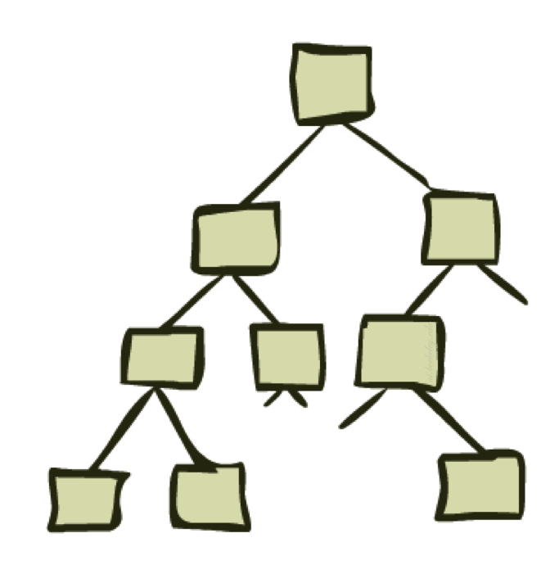
State Space Graphs and Search Trees

Slide 12
Search Trees
This is now / start
“N”, 1.0
“E”, 1.0
Possible futures
A search tree:
A “what if” tree of plans and their outcomes
The start state is the root node
Children correspond to successors
Nodes show states, but correspond to PLANS that achieve those states
For most problems, we can never actually build the whole tree
Notes:
Different plans that achieve the same state, will be different nodes in the tree.

Slide 13
State Space Graphs vs. Search Trees
State Space Graph
Each NODE in in the search tree is an entire PATH in the state space graph.
Search Tree
S
a
G
d
e
p
b
c
q
b
c
e
h
r
d
e
f
a
a
h
r
p
q
f
S
h
We construct both on demand – and we construct as little as possible.
p
q
f
q
c
G
p
q
r
q
c
G
a
a

Slide 14

Quiz: State Space Graphs vs. Search Trees
Consider this 4-state graph:
How big is its search tree (from S)?
a
S
G
b
Important: Lots of repeated structure in the search tree!

Slide 15
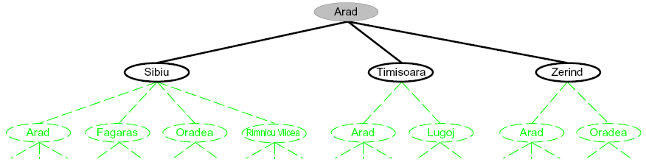
Searching with a Search Tree
Search:
Expand out potential plans (tree nodes)
Maintain a fringe of partial plans under consideration
Try to expand as few tree nodes as possible

Slide 16
class Node: """AIMA: A node in a search tree. Contains a pointer to the parent (the node hat this is a successor of) and to the actual state for this node. Note that if a state is arrived at by two paths, then there are two nodes with he same state. Also includes the action that got us to this state, and the total path_cost (also known as g) to reach the node. Other functions may add an f and h value; see best_first_graph_search and astar_search for an explanation of how the f and h values are handled. You will not need to subclass this class. """ def __init__(self, state, parent=None, action=None, path_cost=0): "Create a search tree Node, derived from a parent by an action." self.state = state self.parent = parent self.action = action if parent: self.path_cost = parent.path_cost + path_cost self.depth = parent.depth + 1 else: self.path_cost = path_cost self.depth = 0 def __repr__(self): return "<Node %s>" % (self.state,) def nodePath(self): "Create a list of nodes from the root to this node." x, result = self, [self] while x.parent: result.append(x.parent) x = x.parent result.reverse() return result def expand(self, problem): """ Return a list of nodes reachable from this node. """ return [Node(next, self, act, cost) for (next, act, cost) in problem.getSuccessors(self.state)]

Slide 17
class SearchAgent(Agent): """ This very general search agent finds a path using a supplied search algorithm for a supplied search problem, then returns actions to follow that path. As a default, this agent runs DFS on a PositionSearchProblem to find location (1,1) Options for fn include: depthFirstSearch or dfs breadthFirstSearch or bfs Note: You should NOT change any code in SearchAgent """ def __init__(self, fn='depthFirstSearch', prob='PositionSearchProblem', heuristic='nullHeuristic'): # Warning: some advanced Python magic is employed below to find the right functions and problems # Get the search function from the name and heuristic if fn not in dir(search): raise AttributeError, fn + ' is not a search function in search.py.' func = getattr(search, fn) if 'heuristic' not in func.func_code.co_varnames: print('[SearchAgent] using function ' + fn) self.searchFunction = func else: if heuristic in globals().keys(): heur = globals()[heuristic] elif heuristic in dir(search): heur = getattr(search, heuristic) else: raise AttributeError, heuristic + ' is not a function in searchAgents.py or search.py.' print('[SearchAgent] using function %s and heuristic %s' % (fn, heuristic)) # Note: this bit of Python trickery combines the search algorithm and the heuristic self.searchFunction = lambda x: func(x, heuristic=heur) # Get the search problem type from the name if prob not in globals().keys() or not prob.endswith('Problem'): raise AttributeError, prob + ' is not a search problem type in SearchAgents.py.' self.searchType = globals()[prob] print('[SearchAgent] using problem type ' + prob)

Slide 18
def registerInitialState(self, state): ""“ This is the first time that the agent sees the layout of the game board. Here, we choose a path to the goal. In this phase, the agent should compute the path to the goal and store it in a local variable. All of the work is done in this method! state: a GameState object (pacman.py) ""“
if self.searchFunction == None: raise Exception, "No search function provided for SearchAgent" starttime = time.time() problem = self.searchType(state) # Makes a new search problem self.actions = self.searchFunction(problem) # Find a path totalCost = problem.getCostOfActions(self.actions) print('Path found with total cost of %d in %.1f seconds' % (totalCost, time.time() - starttime)) if '_expanded' in dir(problem): print('Search nodes expanded: %d' % problem._expanded) def getAction(self, state): """ Returns the next action in the path chosen earlier (in registerInitialState). Return Directions.STOP if there is no further action to take. state: a GameState object (pacman.py) """ if 'actionIndex' not in dir(self): self.actionIndex = 0 i = self.actionIndex self.actionIndex += 1 if i < len(self.actions): return self.actions[i] else: return Directions.STOP

Slide 19
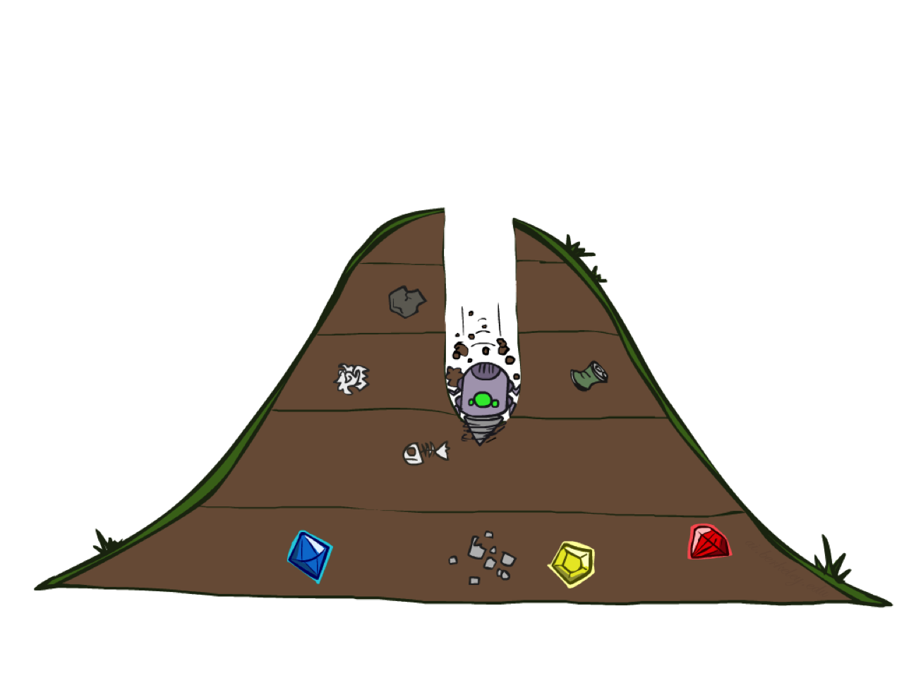
Depth-First Search

Slide 20
Depth-First Search
Strategy: expand a deepest node first
Implementation: Fringe is a LIFO stack
a
G
a
c
b
c
b
e
d
e
d
f
f
S
h
h
p
p
r
q
r
q
S
d
e
p
b
c
e
h
r
q
a
a
h
r
p
q
f
p
q
f
q
c
G
q
c
G
a
a

Slide 21
General Tree Search
Important ideas:
Fringe
Expansion
Exploration strategy
Main question: which fringe nodes to explore?

Slide 22
Search Algorithm Properties
Complete: Guaranteed to find a solution if one exists?
Optimal: Guaranteed to find the least cost path?
Time complexity?
Space complexity?
Cartoon of search tree:
b is the branching factor
m is the maximum depth
solutions at various depths
Number of nodes in entire tree?
1 + b + b² + …. b^{m} = O(b^{m})
1 node
b
…
b nodes
b² nodes
m tiers
b^{m} nodes

Slide 23
Depth-First Search (DFS) Properties
What nodes DFS expand?
Some left prefix of the tree.
Could process the whole tree!
If m is finite, takes time O(b^{m})
How much space does the fringe take?
Only has siblings on path to root, so O(bm)
Is it complete?
m could be infinite, so only if we prevent cycles (more later)
Is it optimal?
No, it finds the “leftmost” solution, regardless of depth or cost
1 node
b
…
b nodes
b² nodes
m tiers
b^{m} nodes

Slide 24
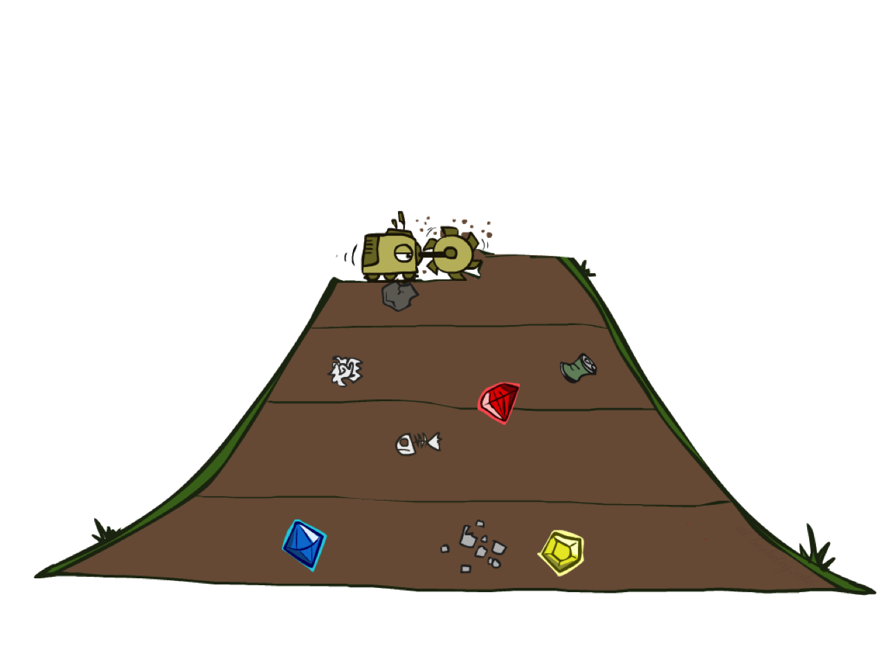
Breadth-First Search

Slide 25
Breadth-First Search
Strategy: expand a shallowest node first
Implementation: Fringe is a FIFO queue
a
G
b
c
d
e
f
S
h
p
q
r
S
d
e
p
Search
Tiers
b
c
e
h
r
q
a
a
h
r
p
q
f
p
q
f
q
c
G
q
c
G
a
a

Slide 26
Breadth-First Search (BFS) Properties
What nodes does BFS expand?
Processes all nodes above shallowest solution
Let depth of shallowest solution be s
Search takes time O(b^{s})
How much space does the fringe take?
Has roughly the last tier, so O(b^{s})
Is it complete?
s must be finite if a solution exists, so yes!
Is it optimal?
Only if costs are all 1 (more on costs later)
1 node
b
…
b nodes
s tiers
b² nodes
b^{s} nodes
b^{m} nodes

Slide 27
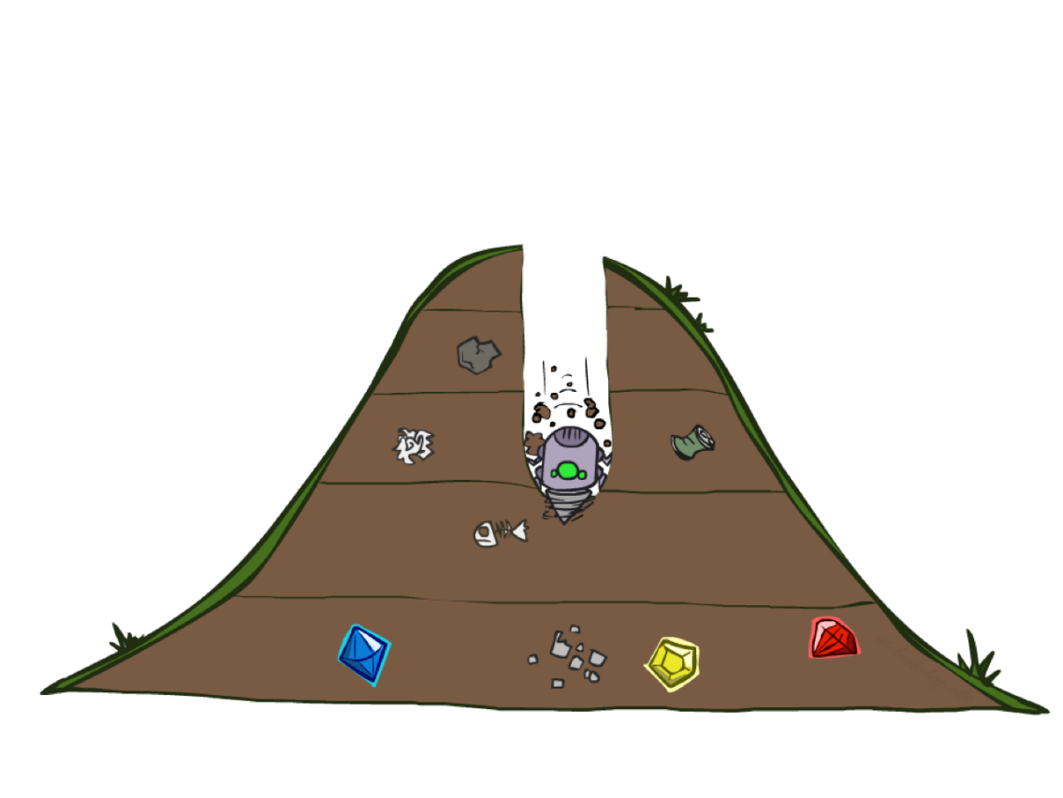
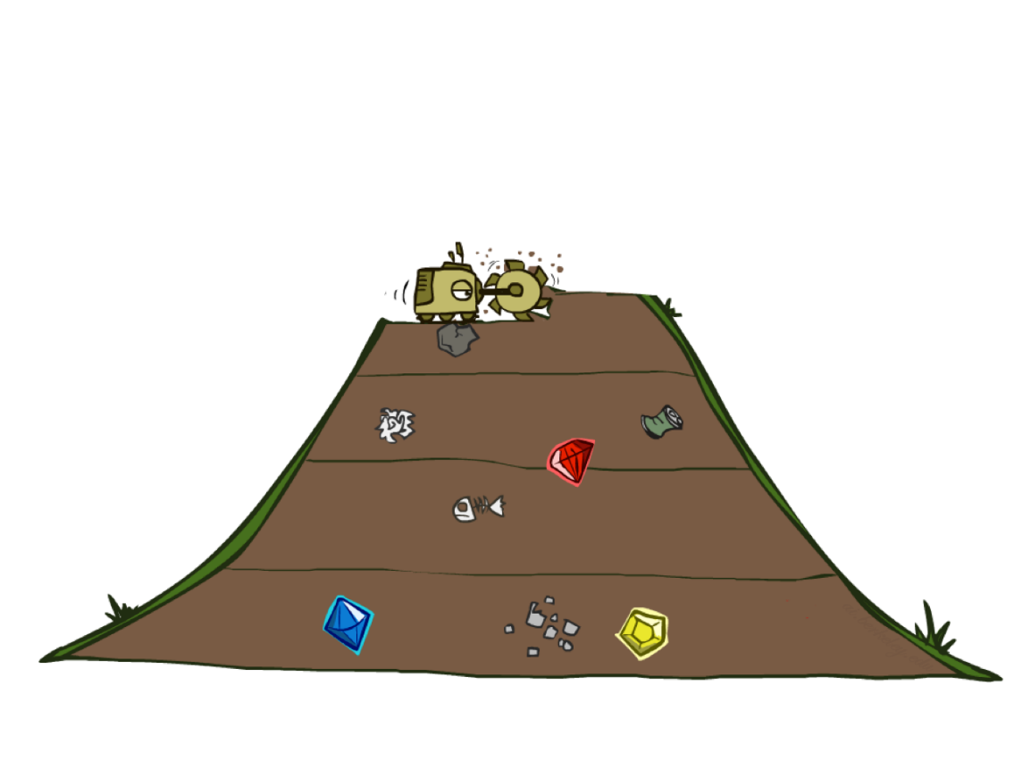
Quiz: DFS vs BFS

Slide 28
Quiz: DFS vs BFS
When will BFS outperform DFS?
When will DFS outperform BFS?
[Demo: dfs/bfs maze water (L2D6)]

Slide 29
Quiz: DFS vs BFS
When will BFS outperform DFS?
When will DFS outperform BFS?
Memory limitation
Goals are mostly at the bottom of the search trees
[Demo: dfs/bfs maze water (L2D6)]

Slide 30
Iterative Deepening
Idea: get DFS’s space advantage with BFS’s time / shallow-solution advantages
Run a DFS with depth limit 1. If no solution…
Run a DFS with depth limit 2. If no solution…
Run a DFS with depth limit 3. …..
Isn’t that wastefully redundant?
Generally most work happens in the lowest level searched, so not so bad!
b
…

Slide 31
Cost-Sensitive Search
a
GOAL
2
2
b
c
3
2
1
8
2
e
d
f
3
9
8
2
START
h
1
4
2
p
4
r
15
q
BFS finds the shortest path in terms of number of actions.
It does not find the least-cost path. We will now cover
a similar algorithm which does find the least-cost path.

Slide 32
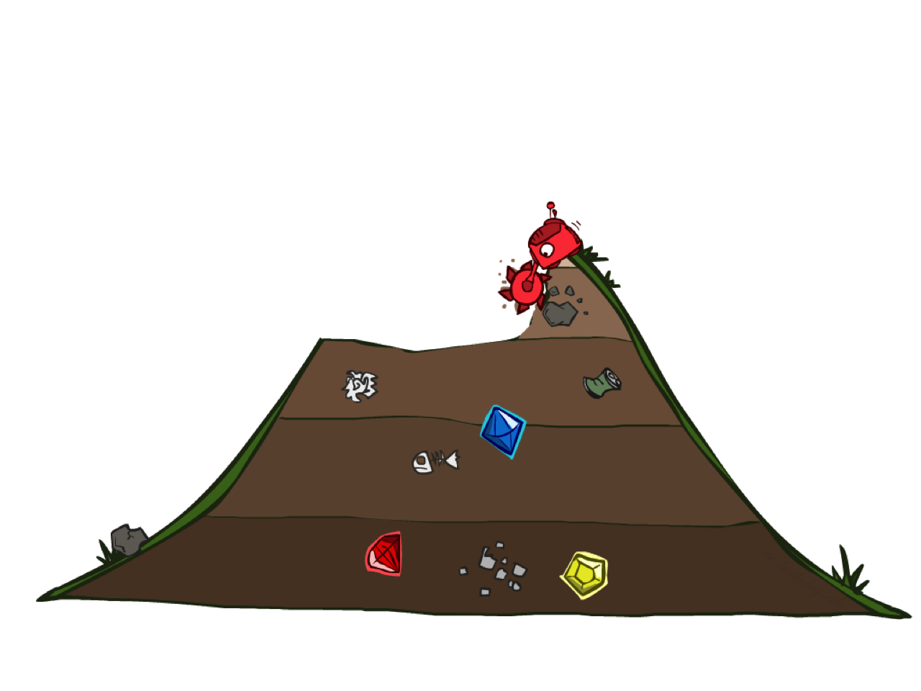
Uniform Cost Search

Slide 33
Uniform Cost Search
2
G
a
Strategy: expand a cheapest node first:
Fringe is a priority queue (priority: cumulative cost)
b
c
1
8
2
2
e
3
d
f
9
8
2
S
h
1
1
p
q
r
15
0
S
d
3
e
9
p
1
b
4
e
5
h
17
r
11
q
16
c
11
Cost contours
a
6
a
h
13
r
7
p
q
f
p
q
f
8
q
c
G
q
c
a
11
G
10
a

Slide 34
Uniform Cost Search
Insert the root into the queue While the queue is not empty Dequeue the maximum priority element from the queue (If priorities are same, alphabetically smaller path is chosen) If the path is ending in the goal state, print the path and exit Else Insert all the children of the dequeued element, with the cumulative costs as priority

Slide 35
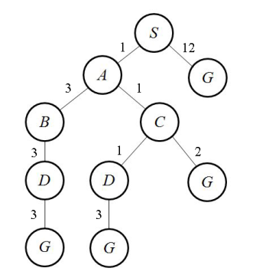
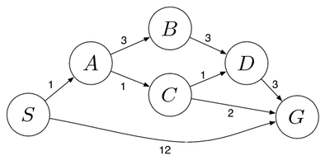
Initialization: { [ S , 0 ] } Iteration1: { [ S->A , 1 ] , [ S->G , 12 ] } Iteration2: { [ S->A->C , 2 ] , [ S->A->B , 4 ] , [ S->G , 12] } Iteration3: { [ S->A->C->D , 3 ] , [ S->A->B , 4 ] , [ S->A->C->G , 4 ] , [ S->G , 12 ] } Iteration4: { [ S->A->B , 4 ] , [ S->A->C->G , 4 ] , [ S->A->C->D->G , 6 ] , [ S->G , 12 ] } Iteration5: { [ S->A->C->G , 4 ] , [ S->A->C->D->G , 6 ] , [ S->A->B->D , 7 ] , [ S->G , 12 ] } Iteration6 gives the final output as S->A->C->G.

Slide 36
Uniform Cost Search (UCS) Properties
What nodes does UCS expand?
Processes all nodes with cost less than cheapest solution!
If that solution costs C* and arcs cost at least ε , then the “effective depth” is roughly C*/ε
Takes time O(b^{C*/ε}) (exponential in effective depth)
How much space does the fringe take?
Has roughly the last tier, so O(b^{C*/ε})
Is it complete?
Assuming best solution has a finite cost and minimum arc cost is positive, yes!
Is it optimal?
Yes! (Proof next lecture via A*)
b
c ≤ 1
…
C*/ε “tiers”
c ≤ 2
c ≤ 3

Slide 37
Uniform Cost Issues
Remember: UCS explores increasing cost contours
The good: UCS is complete and optimal!
The bad:
Explores options in every “direction”
No information about goal location
We’ll fix that soon!
…
c ≤ 1
c ≤ 2
c ≤ 3
Start
Goal
[Demo: empty grid UCS (L2D5)]
[Demo: maze with deep/shallow water DFS/BFS/UCS (L2D7)]

Slide 38

The One Queue
All these search algorithms are the same except for fringe strategies
Conceptually, all fringes are priority queues (i.e. collections of nodes with attached priorities)
Practically, for DFS and BFS, you can avoid the log(n) overhead from an actual priority queue, by using stacks and queues
Can even code one implementation that takes a variable queuing object

